Slide 1
James E. Lyons, Sr.
AGB Senior Consultant
Equity and Inclusion and
the Role of Boards
Massachusetts Department of Higher Education
March 28, 2019

Slide 2
Difficult conversations
Why is it difficult for Boards to have conversations about equity and inclusion?
Personally, how equipped do you feel
to navigate issues of equity and
inclusion as a board member?

Slide 3
Key questions to consider:
Are our policies welcoming to all students?
How can we know if our institution is making progress? What should we assess? What metrics should we use?

Slide 4
Actions to consider:
Establish an equity and inclusion
task force.
Conduct an equity and inclusion
policy review.
Develop an institutional statement
on equity and inclusion.

Slide 5
Actions to consider (cont’d):
Develop a board policy on equity
and inclusion.
Conduct a board self-assessment.
Create an ongoing plan for concerns related to equity and inclusion.

Slide 6
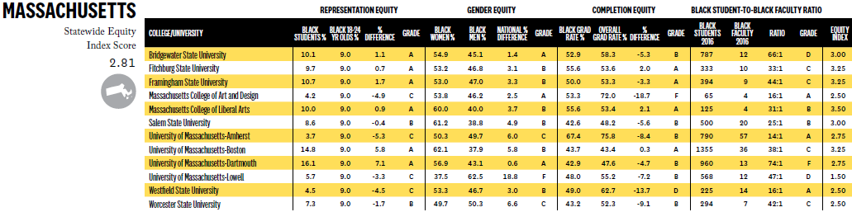
2019 Report: USC Center for Race and Equity
Four-year public institutions in Massachusetts

Slide 7
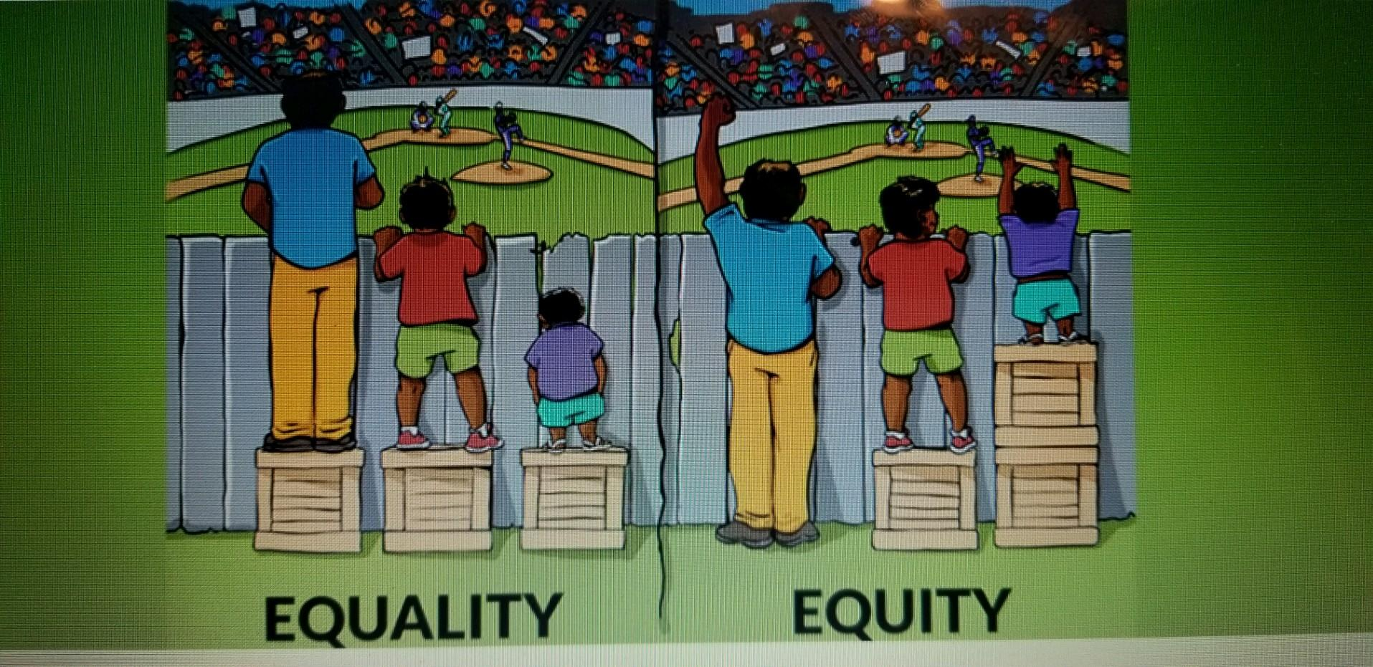
“Interaction Institute for Social Change | Artist: Angus Maguire.” interactioninstitute.org and madewithangus.com.

